Slide 1
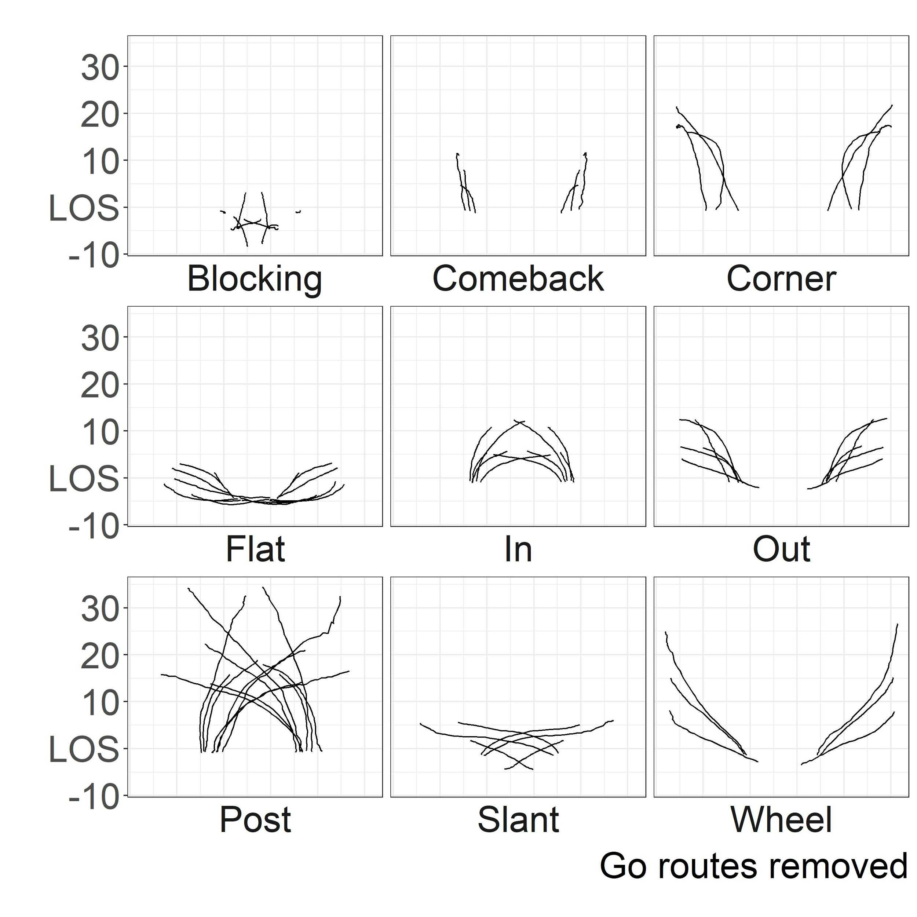
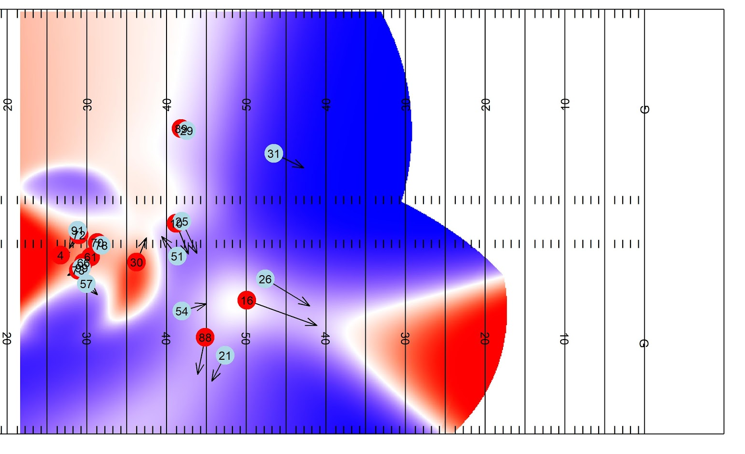

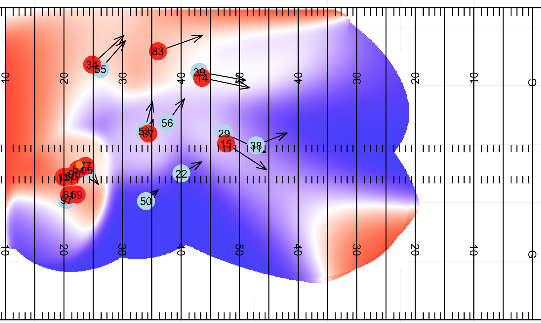
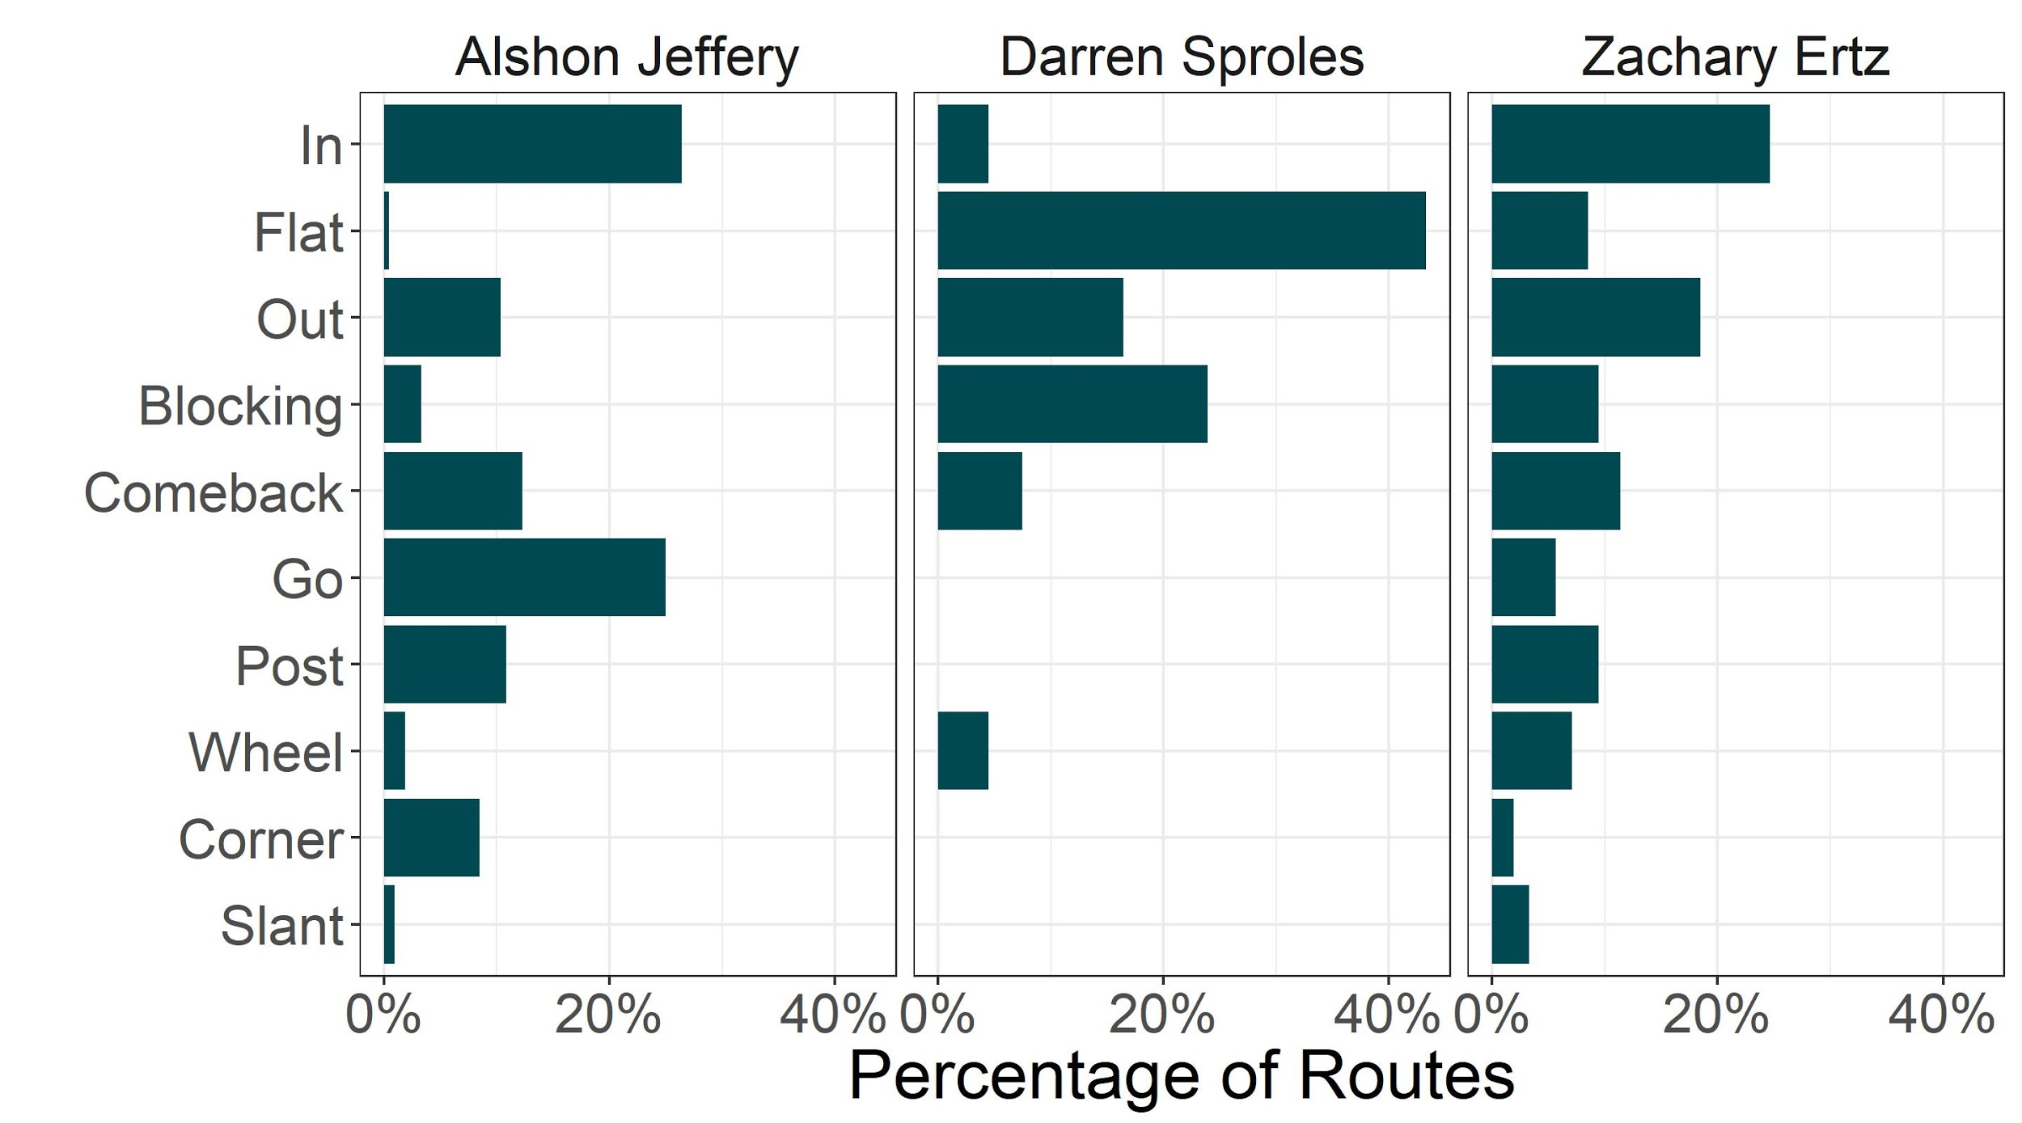
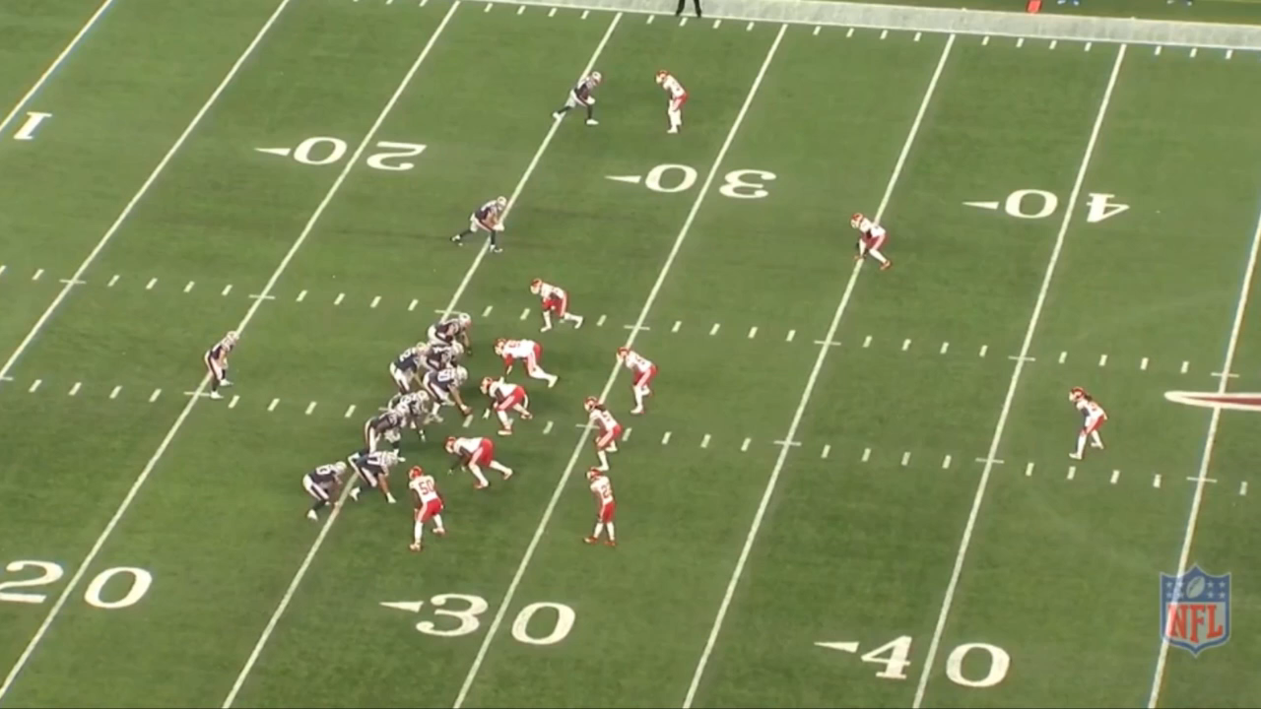
The Routes to Success
Dani Chu, Matthew Reyers, James Thomson, Lucas Wu
Simon Fraser University
Route Identification
Evaluating Route Combinations
Openness - Completion
Play Database
Using the labeled routes, we fit Ridge Regression models to measure the effect of a route duo on a play compared to an average route duo accounting for defensive personnel on the field
Expected Points Added measured play potential
Play Success (if EPA > 0) measured consistency
We classified duos into 4 groups. Examples below
Can identify, time (for connecting with film) play description, results and more based on:
Team
Players
Routes Run
Location
Examples
Plays where DeAndre Hopkins ran a slant
Plays from the 4th quarter with Alvin Kamara in the flat
Offense
Neutral
Defense
 | Consistent | Inconsistent
High Potential | Out & Go Corner & Post Comeback & Post | Wheel & Go In & Corner Post & Go
Low Potential | In & Out In & Comeback Out & Slant | Out & Wheel Corner & Go Slant & Wheel
Openness - Incompletion
We used pattern recognition (Model Based Clustering for Functional Data) to group similarly shaped routes and labelled each group appropriately
Actionable Results
Use player route profiles to quickly understand player tendencies and effectiveness
Use route combination evaluation tools to revise play books, design new plays, and evaluate plays throughout the season
Use play database to quickly identify plays of interest for film study
Route Profiles
Openness
Openness - Incompletion Film
We want to evaluate play designs with regard to design rather than outcome
We suggest Openness as a process-based approach
Can identify if we are opening up the areas of the field that the play was designed to open
Can be expanded with play information
Value of different areas of the field
Down and distance to go
Desired outcome
Acknowledgements
Simon Fraser University Statistics, Dr. Tim Swartz, Dr. Luke Bornn, Dr. Tom Loughin, Next Gen Stats, Dr. Michael Lopez, Dr. Hadley Wickham
The route profiles generated from our clustering and labelling align with our expectations of players and positions
Notes:
Rotate orientation of Incompletion to match all22 angle
Routes Profiles:
Evaluating Route Combinations: We used EPA to measure both consistency and big play ability, classifying duos into 4 groups. Examples below
110000 effects would be required for a full 5 route tree exploration (10^5 + 10^4)
Had 6800 passing plays with 34000 routes in data set (omitted non-qb running plays)

